Slide 1
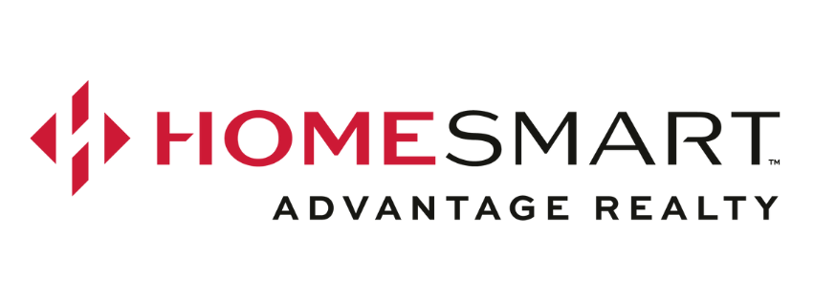
SELLING YOUR BUSINESS
What Every Seller Needs to Know
Prepared for: Business Sellers
Jennifer Jacobs

Slide 2



WHAT DETERMINES YOUR BUSINESS'S VALUE?
Value is not an opinion — it's a function of three measurable factors.
CASH FLOW
ASSET VALUE
RISK
How much money the business actually puts in an owner's pocket each year — before debt and taxes.
The fair market value of equipment, inventory, and other tangible items included in the sale.
Lower risk = higher value. Factors include customer concentration, industry trends, and transferability.

Slide 3
THE NUMBER BUYERS LOOK AT FIRST
SDE
What Gets Added Into SDE:
Owner's salary & payroll taxes
Seller Discretionary
Earnings
Personal perks (car, phone, travel)
The total financial benefit
an owner receives from
the business each year —
including salary, perks,
and profit.
Depreciation & amortization
Interest expense on business debt
One-time or non-recurring expenses
Net income before taxes
SDE × Market Multiple
= Asking Price
HomeSmart Advantage Realty

Slide 4

HOW YOUR BUSINESS IS VALUED
Brokers use two methods together to arrive at a Most Probable Selling Price:
Income Approach
Market Approach
SDE × Multiple = Value
Typical SDE multiples for small businesses range from 1.5× to 3.5× depending on revenue size, industry, and risk factors.
A business generating $200K in SDE might sell for $400K–$600K.
Comparable Sales ("Comps")
Similar businesses that have actually sold are used to benchmark your asking price.
Brokers access national databases of done deals to validate the price — the same way real estate comps work for home sales.
HomeSmart Advantage Realty

Slide 5
WHAT ARE YOU ACTUALLY SELLING?
Most business sales are structured as asset sales. Here's what that typically means:
Equipment & Machinery
Vehicles
Valued at fair market value — not book value.
Valued using Kelly Blue Book or fair market appraisal.
Inventory
Customer List & Goodwill
Valued at cost; physical count near closing.
The most valuable intangible — reflected in your asking price.
Accounts Receivable
Contracts & Licenses
Sometimes included, especially when financing is involved.
Transferable agreements can significantly boost value.
Leasehold Improvements
Cash
Generally no value — they stay with the building.
Typically retained by the seller in an asset sale.
HomeSmart Advantage Realty

Slide 6

YOUR HIDDEN VALUE — PHANTOM ASSETS
These intangibles don't appear on your balance sheet — but they directly drive your asking price.
Loyal customer base
Strong reputation
Prime location
Long-term supplier relationships
Skilled & stable employees
Proprietary systems & processes
Contracts & recurring revenue
Licenses & permits
Name recognition in the market
Backlog of orders
Recession-resistant industry
Low employee turnover
HomeSmart Advantage Realty

Slide 7

IF YOU HAVE AN EIDL LOAN — READ THIS
COVID Economic Injury Disaster Loans (EIDLs) are 30-year SBA loans at 3.75% — and they come with strings attached when selling.
SBA liens must be cleared before you can sell
Loans over $20,000 placed a UCC lien on business assets. These must be released at or before closing.
SBA must approve the change of ownership
The SBA has a formal process — plan ahead, as approvals can take significant time.
Response times are very slow right now
The SBA recently reduced EIDL staffing. Expect delays getting payoff statements and approvals.
Pro tip: Download your payoff statement monthly
Log into your EIDL Loan Portal regularly and save your payoff statement — your escrow officer will need it.
HomeSmart Advantage Realty

Slide 8
YOUR ROADMAP TO A SUCCESSFUL SALE
01
Gather Financials
3 years of P&Ls, tax returns, and balance sheets. The more organized, the faster the process.
02
Broker Opinion of Value
Your broker recasts the financials and runs comps to determine a most probable selling price.
03
List & Market
Your business is confidentially marketed to qualified buyers through broker networks and databases.
04
Buyer Due Diligence
Qualified buyers review your financials under NDA. Expect questions — full transparency speeds this up.
05
Open Escrow & Close
Once terms are agreed, escrow opens. Liens are cleared, SBA approvals obtained, and funds transfer.
HomeSmart Advantage Realty

Slide 9
READY TO KNOW WHAT YOUR
BUSINESS IS WORTH?
We provide a confidential, no-obligation Business Opinion of Value to help you understand what your business could sell for — and when to make your move.
Let's talk about your next chapter.
HomeSmart Advantage Realty

